Slide 1
Small Church Network – Session 2
Presented By:
Susan Aldana – Assistant Controller
Jonathan Blaker – director of Treasury
Andre Kierkiewicz - Controller
September 30, 2019

Slide 2
Essential Topics in Parish Finance
Parochial Report
Financial Statements
Budget

Slide 3
ANNUAL REPORT OF EPISCOPAL CONGREGATIONS AND MISSIONS ACCORDING TO CANONS I.6, I.7, AND I.17 THE PAROCHIAL REPORT Financial section

Slide 6
Financial Reports
Statement of Financial Position – Balance sheet
Statement of Activities – Income Statement
Statement of Cash Flows
Notes:
HANDOUTS
Opening Comment: The Financial Reports prepared by the bookkeeper must serve a diverse audience with different perspectives. Several reports should be prepared each month to address the needs of these various perspectives.
Finance Committee Report: Finance Committee (or finance team from Vestry/Bishop’s Committee) conducts detailed review of receipts and expenses to monitor compliance with budget and purchasing procedures and identify any concerns or problems. (Holy Spirit, Houston also provides a copy of the detailed financials in the church office for inspection by members. This added transparency has proved to build confidence in the financial operations of the parish.)
Vestry Finance Report: Vestry focuses on Big Picture – overall receipts, expenditures, fund balances, etc. – Not line item detail. SAMPLES Available
Congregation Report: Keeps congregation confident financial matters are in order and a reminder to keep their pledges current.

Slide 7
Balance Sheet
Assets
=

Slide 8
Balance Sheet
House Value
=
+

Slide 9
Income Statement
Revenue
-

Slide 10
Income Statement
Revenue
-

Slide 12
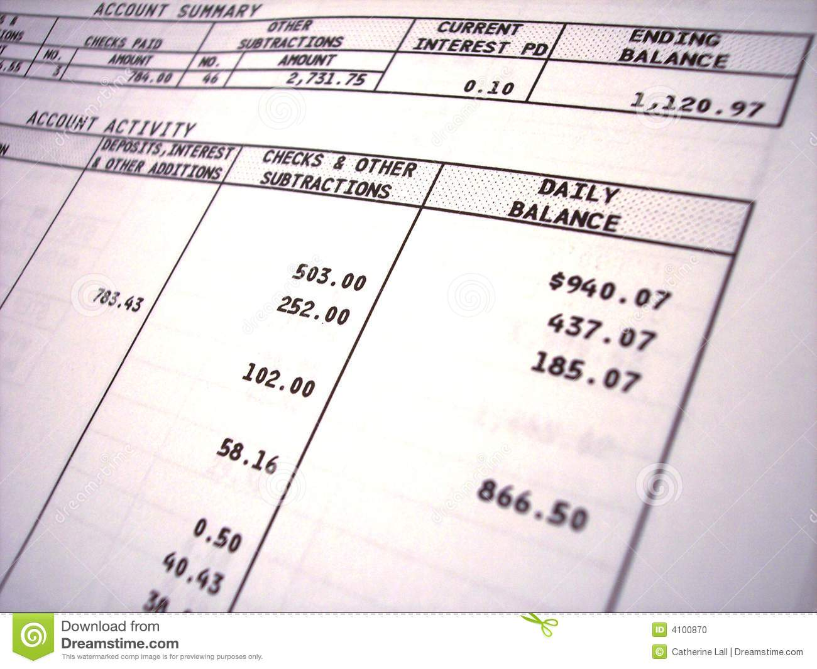
Statement of Cash Flows

Slide 13
Budget
Developing Budget:
Linked to Mission and Vision
Reconciles available resources to ministry requests
Vehicle for funding ministry and programs
Builds on Revenue Forecast
Vestry adopts the Annual Budget and shares it with Congregation
Notes:
Cash Flow – the timing of the receipts
Forecasting in more detail:
Pledge income information:
Pledge cards
Prior years pledge amounts vs. actual pledges receive
Calculate percentage of income received vs pledged.
Loose plate and special events:
Use prior years actual receipts to estimate future periods
Investments income:
Use prior years actual receipts to estimate future periods
Use fees:
Contracts available and past year income
Special items:
Other expected revenues
Specific Components:
Pledges
“Identified Givers”
Loose Plate
Special Events
Capital Fund Drives
Use Fees from outside groups
Investment Income (e.g. special funds, endowment)
Cash Flow – the timing of the receipts

Slide 14
Revenue Forecast
Specific Components:
Pledges
“Identified Givers”
Loose Plate
Special Events
Capital Fund Drives
Use Fees from outside groups
Investment Income (e.g. special funds, endowment)
Cash Flow – the timing of the receipts
Notes:
Stewardship Campaign- Usually in September/October before Thanksgiving to assist in knowing the revenue # for the budget.
Development of Budget- Usually in December
Vestry should also be the keeper of legal docs such as contracts so they are all in one place & so they can be followed accordingly.
Communication w/congregation is key. They look to vestry as the financial stewards of the church’s money and also their money. Is it going to good use? Do they know the financial status of the church? It can help in good & bad/stressful times. Good to designate a person to speak for the vestry to the congregation – can be Treasurer or Chair of Finance Committee.
Opening Comment: Vestry is responsible for developing the revenue forecast. This may be done collectively by the vestry or an individual or a committee may be asked to propose a revenue forecast for Vestry approval.
Identified Givers: Persons who do not fill out a pledge card but have a track record of regular giving, usually by check
Special Events: Auction/Dinner/Dance, Chili Cook-off, Fall Festival, Pumpkin Patch, etc. Comment: I get nervous when these become a big part of the budget – STEWARDSHIP
CASH FLOW: Our churches receipts do not come in 1/12 in every month. Christmas, Easter, December, the summer lull
Capital Fund Drives: New Organ, repair Sanctuary roof, etc.
Use Fees: Charges to community groups and parishioners for non-church use of meeting rooms, gymnasiums, athletic fields, etc.
Forecasting in more detail:
Pledge income information:
Pledge cards
Prior years pledge amounts vs. actual pledges receive
Calculate percentage of income received vs pledged.
Loose plate and special events:
Use prior years actual receipts to estimate future periods
Investments income:
Use prior years actual receipts to estimate future periods
Use fees:
Contracts available and past year income
Special items:
Other expected revenues
Cash Flow – the timing of the receipts

Slide 15
Expense Budget
Similarly, the budget should include expected expenses:
Classified by categories
Organized in a way that allows comparing actual expenses from period to period and against the budgeted amount
Where available actual amounts should be used to all the known expenses like
Past expenses can be used as guidelines.
Every dollar should have a name
Balanced and realistic
Reserves
Notes:
In doubt – overestimate expenses, under revenue
Budget VS Cash flow

Slide 16
Resources
Diocesan Personnel
The Rev. Canon Joann Saylors – Mission Amplification
Linda Riley Mitchell - Chief Financial Officer
lmitchell@epicenter.org
Andre Kierkiewicz - Controller
akierkiewicz@epicenter.org
Susan Aldana - Assistant Controller
saldana@epicenter.org

Slide 17
Resources
Diocesan Personnel
Jonathan Blaker – Director of Treasury
jblaker@epicenter.org
David Fisher - Foundations & Property
dfisher@epicenter.org
Zee Turnbull - Human Resources Administrator
zturnbull@epicenter.org
EDOT: 713-520-6444

Slide 18
Resources
Clergy Manual (each priest has a copy)
Vestry Resource guide
Manual of Business Methods (TEC)
Download from Diocesan website:
http://www.epicenter.org/diocese/the-office-of-financial-services/
Available in English, y en Español
Vestry Resource Guide from Forward Movement
The Vestry Handbook from Church Publishing
Financial Management for Episcopal Parishes

Slide 19
Q&A

