Slide 1
Small Church Network – Session 1
Presented By:
Jonathan Blaker – director of Treasury
Andre Kierkiewicz - Controller
September 29, 2019

Slide 2
Essential Topics in Parish Finance
For I know the plans I have for you Declares the Lord, plans to prosper you and not to harm you, plans to give you hope and a future
-Jeremiah 29:11
Financial Role of Vestry
Internal Controls
Banking
Risk Management
Property
Resources

Slide 3
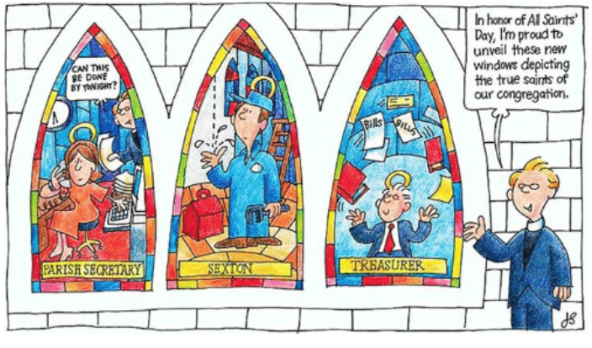
Separation of Functions: Positions
Treasurer
Oversees of financial functions
Bookkeeper
Prepares checks
Maintains financial records
Finance Committee (or designated persons)
Signs checks and disperse funds
Rector/Vicar
Does not have financial duties, including check signing
Notes:
This is how typical church of your size is organized:
Key Finance Positions: The selection of the Treasurer, members of the Finance and Audit Committees, Auditor, and assuring the qualifications of financial staff.
I know this is hard.
But it is one of the essential building blocks of a sound accounting and reporting structure
Rector/Vicar: The notation here is that the Clergy person should not have involvement in the financial operations and activities.
However, this does not imply that the Rector or Vicar does not share some responsibility with the Vestry for the overall financial health of the parish.
(S)He should attend Finance Committee meetings.
one way, very common not to have all that
Counters
Bank deposit

Slide 4
Assuring adequate financial controls reduces risk of Fraud
Fraud can be perpetrated by:
Outright theft
Not recording transactions in the books
Falsely recording transactions in the books
Lack of control of the offering receipts
Notes:
Check request, Items to talk about:
Approver -
Account code – makes it easier for bookkeep
Backup information (invoice etc.)
Counters report:
Two people counting,
Fill out keep one copy with deposit one attached to receipt recorded by the bookkeeper.
Counters schedule

Slide 5
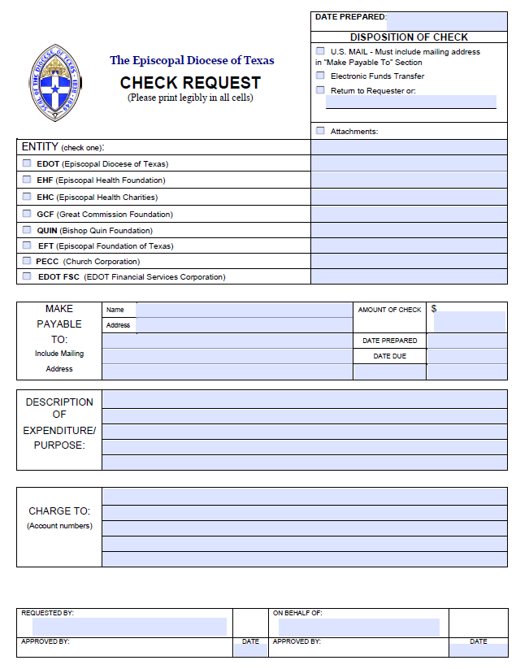

Slide 6
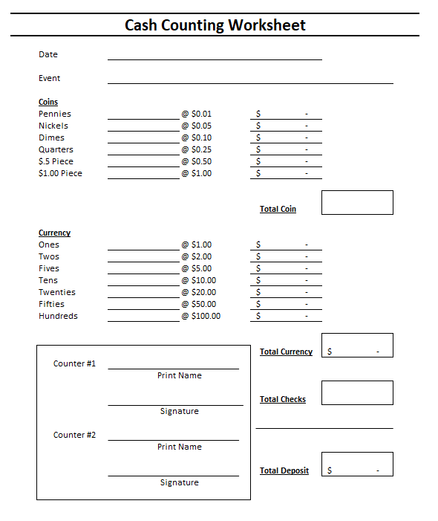

Slide 7
Internal Controls: Best Practices
Written Policies and Procedures
Levels for Authorizations
Segregation of duties
Dual controls
Contemporaneous recordkeeping
Monitoring
Notes:
Written policies and procedures such as: who counts cash, who deposits, who reconciles, who signs checks? Approval of expenses over a certain amount? 2 signers on checks over a certain $ amount?
Internal controls are the backbone of your reporting structure
They are not designed primarily to stop theft, they are set up to ensure the integrity of the financial records. Hopefully, they will deter those who are tempted
Segregation of Duties: the smaller your church the harder this becomes and that makes it more important to have dual controls. Being good stewards of the money
Keep the records up to date
Monitor the financials for things that look out of line. Monitor the use of checks. Monitor Bank reconciliations.

Slide 8
Financial Role of Vestry
Assure adequate Financial Controls
Appoint Key Finance Positions
Assign responsibility for the Stewardship of programs, ministries, facilities, and property of the church
Appoint the Finance Committee
Establish and approve annual Revenue Forecast
Annual Stewardship Campaign
Direct development of, and approve annual Budget (and any changes thereto)
Appoint the Annual Audit Committee
Notes:
Financial Controls: The policies and procedures that provide a high level of integrity, and checks and balances, in the handling of the money that flows through the churches accounts.
Key Finance Positions: The selection of the Treasurer, members of the Finance and Audit Committees, Auditor, and assuring the qualifications of financial staff.
Stewardship: You are responsible for the temporal well being of the Congregation. Title III Canon 2.9 – Authorities and Duties of the Vestry
The vestry has fiduciary responsibility of the church. Each vestry person is fiduciarily liable for the finances of the congregation. So if you are on the vestry, you are personally liable for the finances of the parish in addition to being personally responsible. Two important things to remember – communication with Congregation & internal controls.

Slide 9
Internal Controls – Small Group
Why is it important to have Internal Controls?
What are Internal Controls designed to prevent or identify:
Notes:
Why is it important to have Internal Controls?
Allows for the creation of an audit trail
Adequately safeguard the cash, property and other assets.
Ensure that all financial transactions are appropriately documented and approved by authorized staff.
Funds are expended in accordance with donor requirements and limits.
Ensure that financial reporting is accurate, timely and conforms to policies.
What are Internal Controls designed to prevent or identify:
Inadvertent errors
Prevent misuse of funds or theft
Assure reliability and integrity of record keeping
Share Questionnaire

Slide 10
Internal Controls
Key points to remember when setting or reviewing your controls:
Internal controls will aid in the creation of an audit trail
Segregation of Duties
No one person should handle all aspects of a single transaction. The responsibility for authorization, accounting for and custody of the related asses must be separated.
A transaction involves 5 steps: Request, Approval, Authorization, Execution and Recording
Signers – Individuals authorized by the Vestry to conduct banking transactions on behalf of the church.
Authority levels are defined by Vestry
Remember: Control systems only work if authority and responsibility levels are defined and this structure of responsibility is known within the organization.
Notes:
Signers……. Individuals authorized by the Vestry to conduct banking transactions on behalf of the church.
It is important to keep this list up to date both internally and at the banking institutions.

Slide 11
Internal Control Q&A

Slide 12
The 4-1-1 on Money
Notes:
Talk about Collection and Counting. Get an example from the audience.
Have them describe the process and the what if or what could go wrong

Slide 13
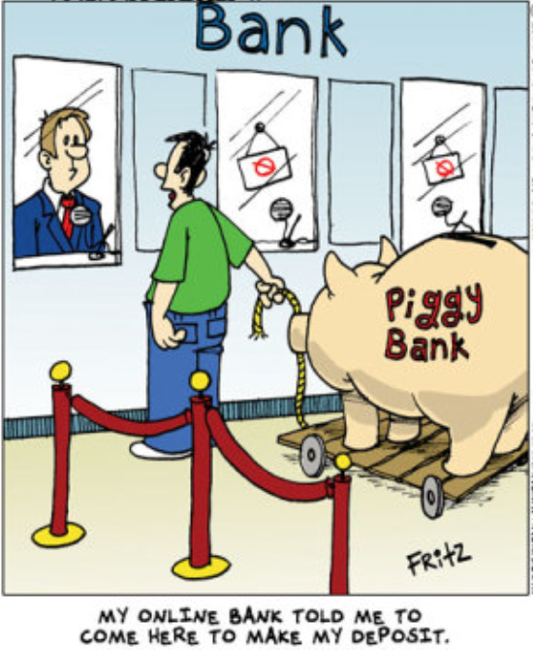
The 4-1-1 on Money
The Green Cash…… It’s good, right!?!?!
Online Giving….. Who’s in?
Investment Opportunities
Participating Fund
***NEW*** Income Fund
Notes:
Talk about Collection and Counting. Get an example from the audience.
Have them describe the process and the what if or what could go wrong

Slide 14
The Basics of Banking
What type of bookkeeping system should we use?
How many bank accounts do we need?
Who should be able to sign checks?
Who should deposit the weekly receipts in the bank, and how?
Signers
Must be authorized by the Vestry
Kept up to date at the Bank
Typically have full access to the account, it is important to keep the signers up to date
Notes:
These are just some of the questions to be answered when setting up an accounting system for a congregation. Such questions should be periodically reviewed.
Bookkeeping – We will get into that later
How Many Bank accounts does one need?
That is up to each Church. Let’s talk about a few basic accounts that are needed and how we could use them.
DDA, also know as Demand Deposit Accounts or easier, a Checking Account. What can we do with a checking account:
Write Checks, Deposit money, pay bills online, set up direct debit for bills, keep “extra” money …….. These are all things we could do, pretty plain vanilla
What are some other things that we could use a checking account for? Receipt of online giving? Show of hands, is anyone in here using online giving, an app or other tool for allowing people to give?
Talk about the cost concerns and give an few examples, maybe northside or Holy Family
Sometimes there is money more than what is needed for our normal operations or dollars that have been given for a specified purpose, restricted funds. Now let’s talk about what we could do with these dollars….
Savings Account or CD’s – What is the main difference in these two types of accounts?
Signers……. Individuals authorized by the Vestry to conduct banking transactions on behalf of the church.
It is important to keep this list up to date both internally and at the banking institutions.

Slide 15
Online Giving – Open Discussion

Slide 16
Online Giving
Notes:
According to this 2018 Global Trends giving report, I want to highlight the similarity of the online giving. Also take a look at the social media similarity

Slide 17
Charitable Giving For Churches
Giving to religion has consistently remained America’s single largest recipient
49% of all church giving transactions are made with a card
60% are willing to give to their church digitally
Churches that accept online giving increase overall donations by 32%
Source: nonprofitsource.com
Notes:
After slide is covered, talk about some of the systems and functionality.

Slide 18
Investment Opportunities

Slide 19
Investment Opportunity
Participating Fund
Longer term dollars with minimum time horizon of 5 to 7 years.
Subject to market fluctuation.
Endowment funds, such as maintenance
***New**** Income Fund – coming soon
Designed for cash funds that should not be open to market risk:
Capital Campaign dollars
Savings that will be held longer than 6 months
Return is based on Fed Funds Target – 25bps
Notes:
Anyone in the group have funds invested in the Participating Fund?
These are funds of the Diocese, parishes and institutions
Are pooled for economic management
Currently total over $40 million
Have a diversified, long-term portfolio of equities, fixed income and alternative investments.

Slide 20
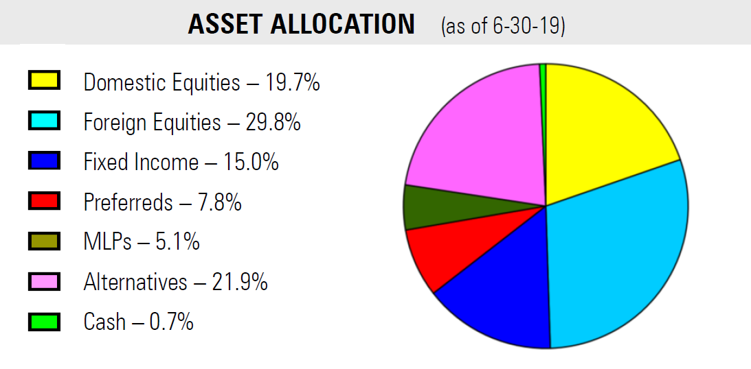
Participating Fund
Notes:
Who may participate?
The Funds are open to any diocesan entity but not to individuals. These funds include rectory funds, endowment funds, scholarship funds, building funds, general funds and bequests.
How are they invested?
The investment policy as established by The Church Corporation Trustees for the Participating Funds contemplates a long-term (5-year) time horizon. The funds are typically invested 40-60% in equities and 20-45% in fixed income vehicles, up to 25% in alternative investments not correlated to the overall market (provides downside protection), and about 5% or less in money market instruments.
How do they operate?
Funds held in the Participating Funds are managed by outside investment managers under a contract with the Church Corporation. Deposits may be made at any time. Withdrawals may be requested as a recurring payment or may be made upon written request. All withdrawals are paid at the end of the month. Separate records are kept of all of the Participating Fund accounts and participants receive monthly statements.

Slide 21
Participating Funds Historic Performance
Year |  | Participating Funds |  | Benchmark Index**
2009 |  | 19.48% |  | 18.25%
2010 |  | 6.80% |  | 9.33%
2011 |  | -3.70% |  | -0.28%
2012 |  | 8.64% |  | 10.07%
2013 |  | 1.35% |  | 8.08%
2014 |  | 4.61% |  | 4.99%
2015 |  | -4.54% |  | -4.33%
2016 |  | 6.16% |  | 5.50%
2017 |  | 13.56% |  | 11.46%
2018 |  | -8.12% |  | -8.15%
2019* |  | 10.88% |  | 11.19%
* Year to Date through June 30, 2019
** Benchmark Index = custom blend of major indices based on current asset allocation

Slide 22
Debt Levels

Slide 23
Debt Service
Debt Load Guidelines and Limits:
Up to 10% = Acceptable debt level. Should be manageable without significant strain on ministries and programs.
10% - 15% = Heavier debt load. Should be manageable but with careful planning.
16% - 19% = Risky debt load. Staffing, programming, and maintenance needs will compete with and often concede priority to debt service in budget decisions and can often negatively impact congregational vitality and growth.
20% = Absolute upper limit. Negatively impacts staffing, programming and other ministries.
An alternative to the 20% maximum debt load is: Debt ≤ $10,000 per pledging unit.
Notes:
It is important to maintain the appropriate levels of debt.

Slide 24
Debt Service
The calculation for Annual Debt Service (total principal and interest payments) ÷ Annual Operating Budget
Example: A church has existing debt and pays $3,350 per month in principal and interest payments. The Church’s annual Operating Budget is $425,000. $3,350 x 12 months = $40,200 ÷ $425,000 = .0946 or 9.5% of the Operating Budget.
Notes:
It is important to maintain the appropriate levels of debt.

Slide 25
Crump Fund
Joe and Jessie Crump Fund was established in the 1960’s for cultural research and low interest rate loans to Episcopal Churches in Texas.
Requirements:
Must be for new construction
The loan amount is not to exceed $500,000.00.
The duration of the loan is determined by the amount of money borrowed but is not to exceed 20 years.
Interest rate on the loan will be 2%.
Stated principal plus interest payment is required annually
The Joe & Jessie Crump Fund must have First Lien position on title.
Notes:
By show of hands, who here has heard of the Crump Foundation and their lending program?

Slide 26
Property, Construction and Insurance

Slide 27
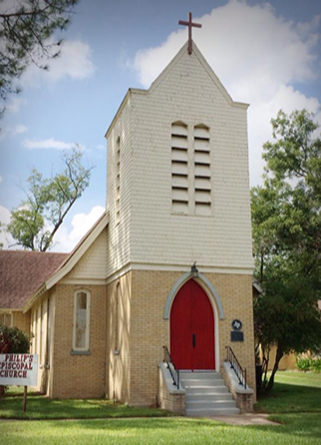
Property
Church Corporation
Protestant Episcopal Church Council of the Diocese of Texas – “Church Corp”
Holds title to all property in the Diocese (Constitution Article 9 and Title V, Canon 8)
Approves all borrowings with property pledges, new construction, improvements, major remodeling, demolition, and sales of property
Any bequiffed property must be approved by Church Corp
Notes:
Church corp and churches

Slide 28
Risk Management
What is risk management?
Risk Management is a disciplined approach to asset conservation. It involves more than just buying insurance; in fact, insurance may well be the court of last resort after the other means of managing risk are thoroughly explored.
It is a two-fold process
Examining the business, property holdings and operational processes to identify all risk that could threaten the Church
Estimating the potential financial impact of the risk. Just be careful to not ignore problems because they are “too small”
Notes:
Risk Management is not just having insurance.
After the two fold process:
Remember that commercial insurance is only one way to handle risk. Consider first whether you can avoid, reduce, assume, or transfer Risk.

Slide 29
Risk Management
What is meant by transfer risk?
Don’t blindly assume risk from third parties, Ask Outside contractors, tenants, users of your facilities, and business partners to provide evidence of their insurance – and have your organization designated an “Additional Insured” whenever possible.
Example: An independent pre-school occupying your facilities should indemnify and hold the church harmless from liability for claims arising from the school’s occupancy or operations. The contract should also require that the pre-school provide evidence of its liability insurance, designating the Church as an additional insured under the pre-school’s insurance.
Notes:
What is meant by risk transfer?
Example
Remember it is also important for anyone working on the property to carry proper insurance and workers comp

Slide 30
Insurance
Title I, Canon 7 (6), states – “All buildings and their contents shall be kept adequately insured”
In addition to insurance coverage for the physical property, each Diocesan entity, as defined in Title II.5 shall be required to have:
General liability insurance coverage of at least one million dollars ($1,000,000.00),
Liability insurance coverage against sexual misconduct which is at least equal to the lesser of (i) the maximum coverage and limits available from the Church Insurance Corporation, or (ii) the coverage and limits required by the Executive Board.
Notes:
Churches must have insurance in accordance with the Canon’s.
Share the Safeguarding your Assists Risk Management & Insurance Basics handout

Slide 31
General Liability Insurance
Purpose: To protect and organization and its agents against civil liability for bodily injury, property damage, or personal injury to others.
Most general liability for not-for-profits protect the following:
The corporate entity (the “Named Insured”);
Its subsidiaries and affiliates;
Their executive officers;
Their employees; and
Their volunteers
….for their actins on the organization’s behalf. Church-related policies may be even more specific in designating ordained clergy, wardens, and vestry members as additional types of Insureds.
Notes:
Let’s talk about insurance a bit more:
Purpose: To protect and organization and its agents against civil liability for bodily injury, property damage, or personal injury to others.
Most general liability for not-for-profits protect the following:
The corporate entity (the “Named Insured”);
Its subsidiaries and affiliates;
Their executive officers;
Their employees; and
Their volunteers
….for their actins on the organization’s behalf. Church-related policies may be even more specific in designating ordained clergy, wardens, and vestry members as additional types of Insureds.
Find out who is protected by your General Liability policy. Does it cover employees and volunteers for their actions on your organization’s behalf?

Slide 32
Directors’ & Officers (D&O) Insurance
Purpose: To protect and organization and its agents against “wrongful acts.”
Most D&O for not-for-profits protect the following:
The entity, boteh in its own right and when it indemnifies Directors & Offices pursuant to its by-laws; and
Its Directors & Officers (as defined in the policy)
Many D&O policies are underwritten on a “Claims-Made” basis
Within the context of a D&O policy, a Wrongful Act is usually defined as:
An Act committed or wrongfully attempted
An error
An omission
A misstatement
A misleading statement
Neglect
A breach of duty
Notes:
Purpose: To protect and organization and its agents against “wrongful acts.”
Most D&O for not-for-profits protect the following:
The entity, boteh in its own right and when it indemnifies Directors & Offices pursuant to its by-laws; and
Its Directors & Officers (as defined in the policy)
Many D&O policies are underwritten on a “Claims-Made” basis
Within the context of a D&O policy, a Wrongful Act is usually defined as:
An Act committed or wrongfully attempted
An error
An omission
A misstatement
A misleading statement
Neglect
A breach of duty

Slide 33
Claims-made Policy Insurance
The claims-made covers incidents that are report during the active policy period - or an extended reporting period - and occur after a policy's retroactive start date. Claims through this form of coverage must meet both criteria for coverage to apply.
What is a retroactive date?
A retroactive date is the specific date a policy's coverage begins. This is generally the policy's effective date or a past date agreed on by the insured.
Extended reporting period
Also known as tail coverage, an extended reporting period is a provision on a policy that extends the amount of time you can report a claim after a policy's cancellation. Most policies typically include tail coverage, and the length of time varies depending on the carrier.
Notes:
There are two different types of policies, a Claims-Made vs Event Date or Occurrence policy
A claims-made policy covers claims that are made during the policy period. ... Most liability policies purchased by small business owners are occurrence policies.
An occurrence policy covers claims resulting from an event during the policy term. Coverage depends on the timing of the event.

Slide 34
Claims-made Policy Insurance
Example: a small business owner purchases a general liability policy on a claims-made basis. The policy is effective from January 1, 2016, through December 31, 2016, and has a retroactive date of October 1, 2015. A claim is reported during the policy period for a loss that occurred on November 10, 2015.
Since the incident was reported during the policy period and occurred after the retroactive date, the claim is covered. Claims-made coverage wouldn't apply had the loss occurred prior to October 1, 2015.
Notes:
There are two different types of policies, a Claims-Made vs Event Date or Occurrence policy
A claims-made policy covers claims that are made during the policy period. ... Most liability policies purchased by small business owners are occurrence policies.
An occurrence policy covers claims resulting from an event during the policy term. Coverage depends on the timing of the event.

Slide 35
Occurrence Policy Insurance
The occurrence form covers losses that take place during a specific coverage period, regardless of when an incident is reported.
An occurrence policy is typically more expensive than claims-made policy because there isn't a limit on the time a claim must be reported.
There's no advantage to having a claims-made coverage over occurrence coverage, and vice versa. It depends on how you'd like your coverages to be activated.
Notes:
There are two different types of policies, a Claims-Made vs Event Date or Occurrence policy
A claims-made policy covers claims that are made during the policy period. ... Most liability policies purchased by small business owners are occurrence policies.
An occurrence policy covers claims resulting from an event during the policy term. Coverage depends on the timing of the event.

Slide 36
Occurrence Policy Insurance
Example, an electrician purchases a general liability policy on an occurrence basis. The policy is effective from January 1, 2016 through December 31, 2016. A claim is reported against the electrician in February 2017, for faulty work completed during the policy period in October 2016. The claim will be covered since the loss occurred during the policy period.
Notes:
There are two different types of policies, a Claims-Made vs Event Date or Occurrence policy
A claims-made policy covers claims that are made during the policy period. ... Most liability policies purchased by small business owners are occurrence policies.
An occurrence policy covers claims resulting from an event during the policy term. Coverage depends on the timing of the event.

Slide 37
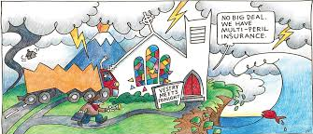
Insurance Open Discussion
COI – Certificate of Insurance
When would you request one?
When might you provide one?
Deductibles and what is covered?
Why might a claim be denied?
Does not meet the deductible
Not covered under the policy
Differed maintenance
Notes:
Example of stained glass or art needing to be noted on the policy
Talk about differed maintenance

Slide 38
Maintenance of Property

Slide 39
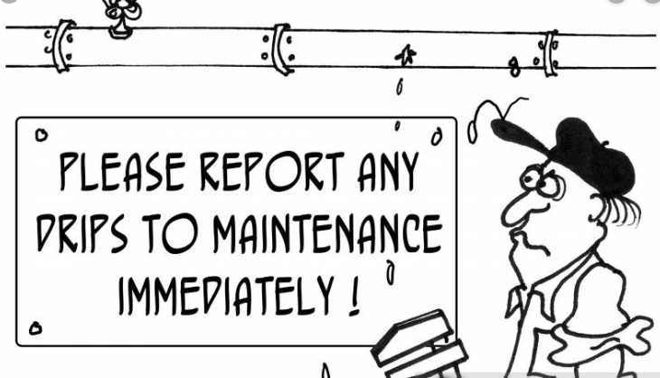
Maintenance of Property
It is important to properly maintain the property to mitigate risk.
Insurance can deny property claims based on deferred maintenance
What is deferred maintenance?
Notes:
Give examples
Window caulk
Rusted siding
Roof damage not fixed
Improper installed drainage i.e. roof in Baytown

Slide 40
Parish Inventory
What is it?
It is a risk management tool.
Where can it be found?
On our website under the finance page
Why should you keep an Inventory?
The contents of your properties have great accumulated value as personal property. In the event they are lost or destroyed, an inventory helps to substantiate the existence of items and, most importantly, the cost to replace them
We also recommend photos
How often should this be updated?
At lease once per year

Slide 41
Resources
Diocesan Personnel
The Rev. Canon Joann Saylors – Mission Amplification
Linda Riley Mitchell - Chief Financial Officer
lmitchell@epicenter.org
Andre Kierkiewicz - Controller
akierkiewicz@epicenter.org
Susan Aldana - Assistant Controller
saldana@epicenter.org

Slide 42
Resources
Diocesan Personnel
Jonathan Blaker – Director of Treasury
jblaker@epicenter.org
David Fisher - Foundations & Property
dfisher@epicenter.org
Zee Turnbull - Human Resources Administrator
zturnbull@epicenter.org
EDOT: 713-520-6444

Slide 43
http://www.epicenter.org/diocese/the-office-of-financial-services/
Webpage:

Slide 44
Q&A

