Slide 1
MONEY STEWARDSHIP
Session One:
Creating a plan

Slide 2
Generous and loving God, so draw our hearts to you, so guide our minds, so fill our imaginations, so control our wills, that we may be yours, utterly dedicated to your service.
Use us and all of our resources— each minute of our day, each of our humble gifts and talents, and even our finances, as you will, and always for your glory and for the welfare of your people, in and through and with the power of your Spirit.
AMEN
T

Slide 3
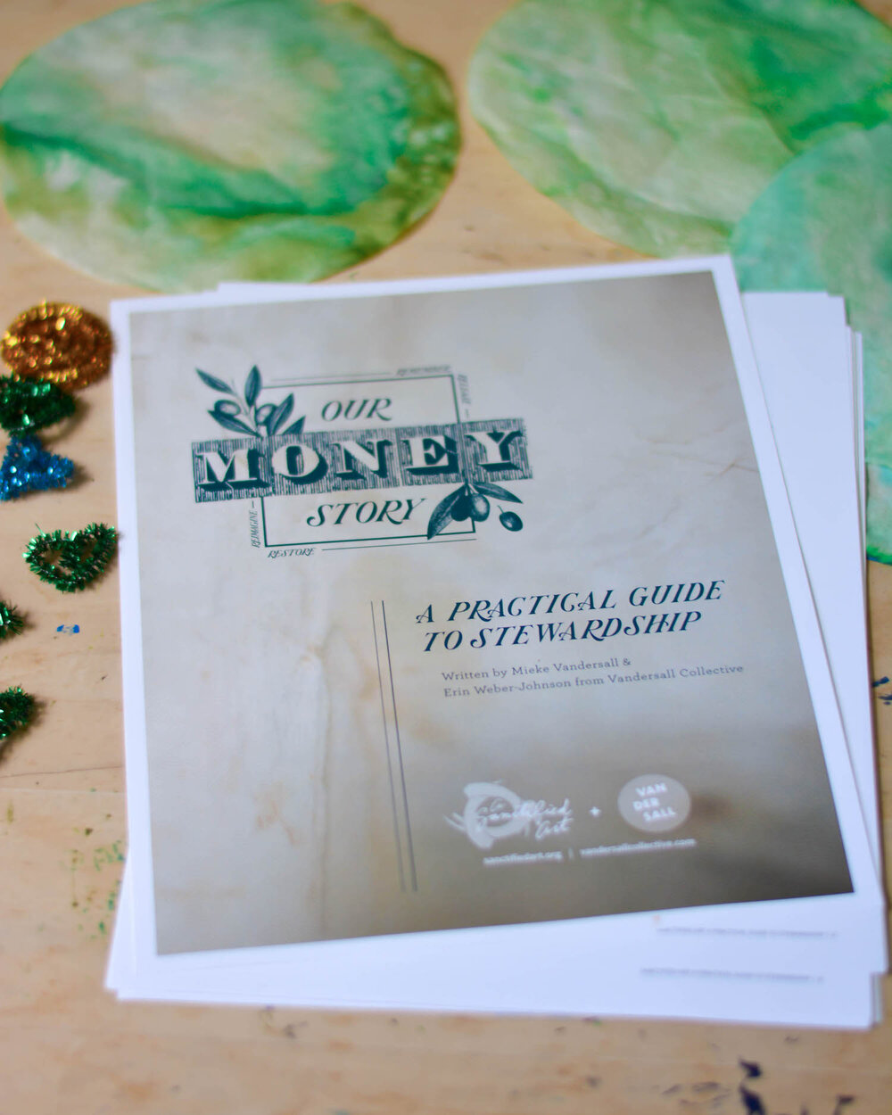

SANCTIFIED ART:
OUR MONEY STORY
Bfain@epicenter.org

Slide 4
?????????

Slide 5
Thank you.
Please.
Share.

Slide 6
National Study of Congregations’ Economic Practices
1200 Congregations between 2014--2017

Slide 7
WHAT IS ESSENTIAL?
???

Slide 8
The Team
How do you choose?
?

Slide 9
The Timeline
When’s the best time?
?

Slide 10
Teaching and Talking and Preaching
Money. Money. Money
?

Slide 11
Offertory Sentences
Let us with gladness present the offerings and oblations of our life and labor to the Lord.
Offer to God a sacrifice of thanksgiving and make good your vows to the Most High.
Psalm 96.8 and so on for eight more Scriptures.
S

Slide 12
Story telling
?

Slide 13
Thank you
Thank you
Thank you
?

Slide 14
The Team
How do you choose?
?

Slide 15
The Timeline
When’s the best time?
?

Slide 16
Teaching and Talking and Preaching
Money. Money. Money
?

Slide 17
Story telling
?

Slide 18
Thank you
Thank you
Thank you
?

Slide 19
MONEY STEWARDSHIP
Session two:
The stewardship letter

Slide 20
MONEY STEWARDSHIP
Session two:
The stewardship letter

Slide 21
SANCTIFIED ART:
OUR MONEY STORY
Bfain@epicenter.org

