Slide 1
MONEY STEWARDSHIP
Session two:
The stewardship letter

Slide 2
Generous and loving God, so draw our hearts to you, so guide our minds, so fill our imaginations, so control our wills, that we may be yours, utterly dedicated to your service.
Use us and all of our resources— each minute of our day, each of our humble gifts and talents, and even our finances, as you will, and always for your glory and for the welfare of your people, in and through and with the power of your Spirit.
AMEN
T

Slide 3
Creating a Team
Creating a Vision
Creating a Timeline
Talking. Teaching. Preaching. $$$
Telling our story
Thank you. Thank you. Thank you.
?

Slide 4
Offertory Sentences
Hebrews 13. 15, 16
Through Christ let us continually offer to God the sacrifice of praise, that is, the fruit of lips that acknowledge God’s Name. But do not neglect to do good and to share what you have, for such sacrifices are pleasing to God.
Book of Common Prayer, pp. 376--377
S

Slide 5
THE STEWARDSHIP LETTER
?

Slide 6
1/10
Not one *magic* thing you can do
???

Slide 7
WHAT IS THE PURPOSE OF OUR STEWARDSHIP LETTER?
???

Slide 8
?????????

Slide 9
Changing the parish culture from stewardship as budget funding to disciple making

Slide 10
Pray
???

Slide 11
Creating the letter
???

Slide 12
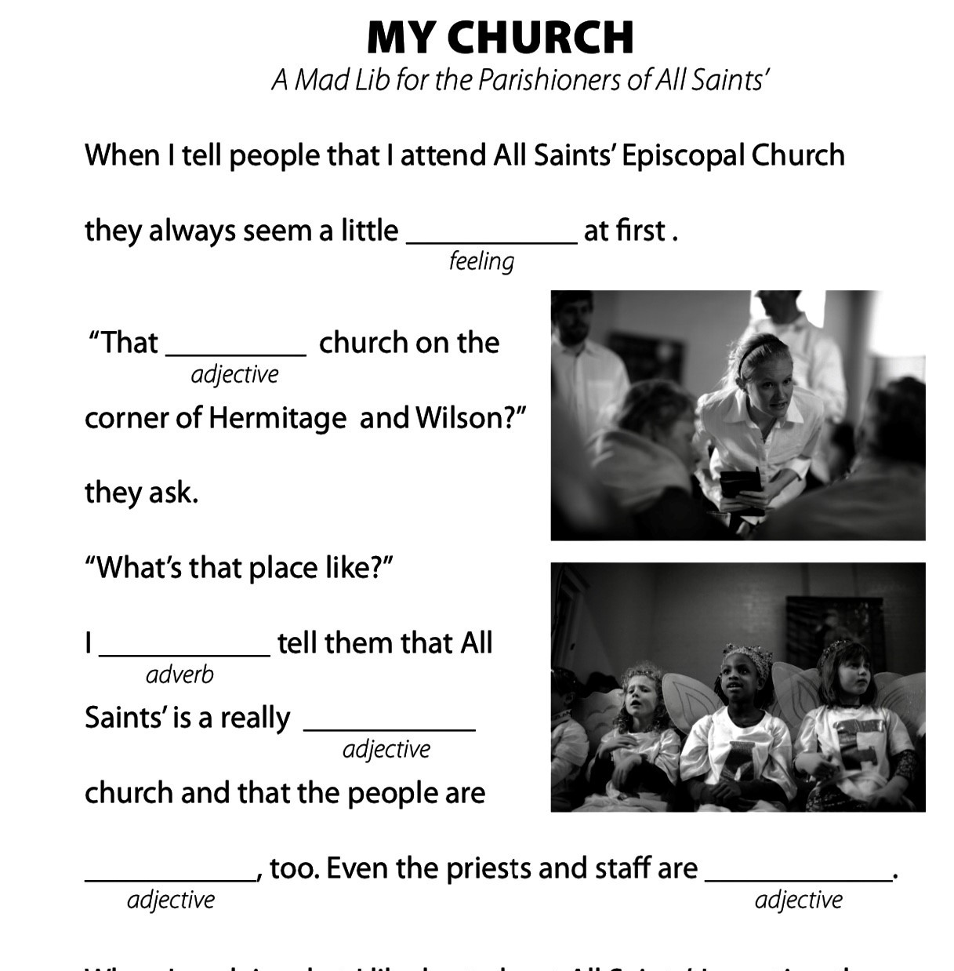
S

Slide 13
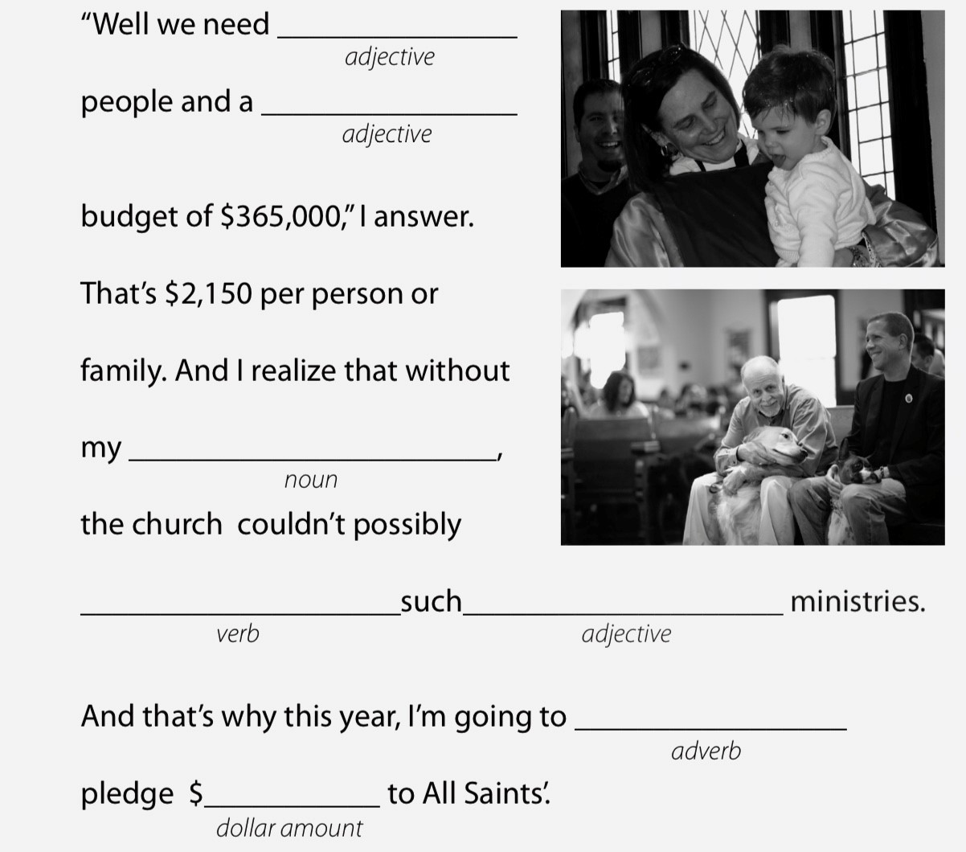
S

Slide 14
Making it distinctive
M

Slide 15
Ways to share it
M

Slide 16
Please.
Share.
Thank you.

Slide 17
Pray
???

Slide 18
?????????

Slide 19
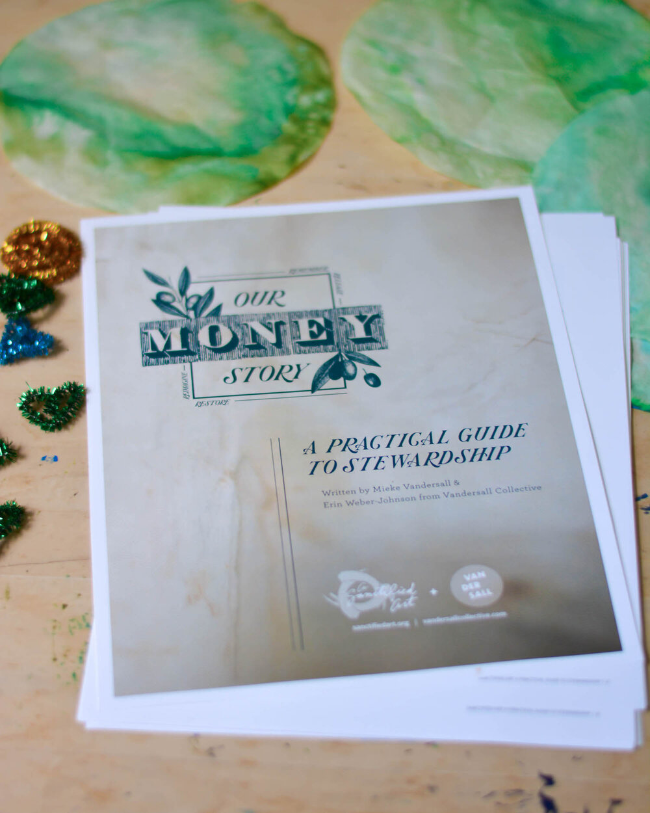

SANCTIFIED ART:
OUR MONEY STORY
Bfain@epicenter.org

Slide 20
MONEY STEWARDSHIP
Session three:
Telling our Story

